Slide 1

TECHNICAL PRESENTATION

Slide 2
What is SQL?
SQL is the standard language for dealing with Relational Databases.
SQL is used to insert, search, update, and delete database records.
SQL

Slide 3
Types of SQL Commands
1
2
3
4
5
DDL
DML
DCL
TCL
DQL
3

Slide 4
TCL commands
Transaction Control Language (TCL) commands are used to manage transactions in the database.
These are used to manage the changes made by DML statements. A transaction is a single unit of work performed against a database.
If it is successful, the data are committed and becomes permanent.

Slide 5
What are TCL Commands
TCL stands for Transaction Control Languages.
These commands are used for maintaining consistency of the database and for the management of transactions made by the DML commands.

Slide 6
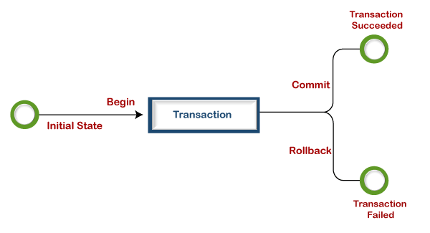
Types of TCL commands

Slide 7
COMMIT Command in TCL
The COMMIT command in SQL is used to permanently save any transaction into the database.
Syntax :
Below given is the syntax of the COMMIT TCL command in SQL.
COMMIT;

Slide 8
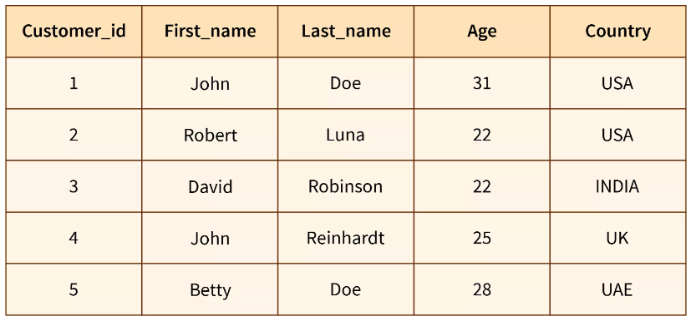
UPDATE Customers SET country = 'INDIA' WHERE first_name = 'David'; COMMIT;
SELECT * FROM Customers;

Slide 9
ROLLBACK Command in TCL
The rollback command in TCL is used for restoring the database to the last committed state.
Syntax:
Below given is the syntax of the ROLLBACK TCL command in SQL.
ROLLBACK;

Slide 10
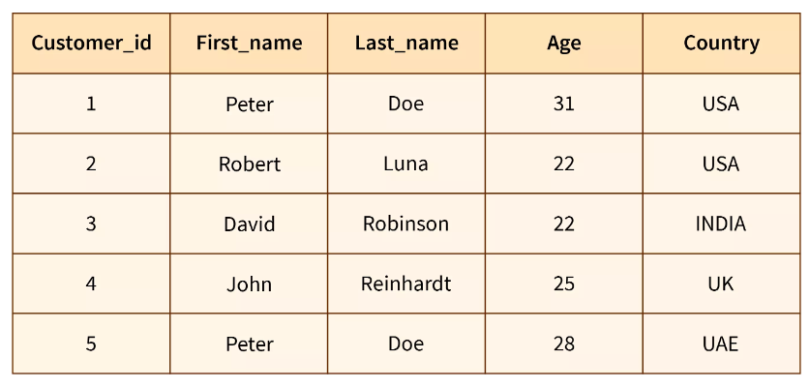
UPDATE Customers SET first_name = 'Peter' WHERE last_name = 'Doe'; ROLLBACK;
SELECT * FROM Customers;
10
SQL

Slide 11
SQL queries using the Commit, Rollback, and Savepoint commands the results is --
Code:
INSERT INTO Employee VALUES(113, 'Rose’);
COMMIT;
UPDATE Employee SET name = 'Oliver' WHERE id = '110’;
SAVEPOINT A;
INSERT INTO Employee VALUES(114, 'Prince’);
SAVEPOINT B;
INSERT INTO Employee VALUES(115, 'Smith’);
SAVEPOINT C;
SELECT * FROM Employee;

Slide 12
Thank you
Shambhavi Joshi
shambhavijoshi20027@gmail.com

